Slide 1
Please write title, subtitle and speaker name in all capital letters
FAIR, PRIVACY-
PRESERVING
AND SECURE AI
STRATA 2019, LONDON
MIKIO L. BRAUN
01-05-2019

Slide 2
AI IS STARTING TO IMPACT OUR LIVES
M. BRAUN, FAIR, PRIVACY PRESERVING AND SECURE AI, STRATA LONDON 2019

Slide 3
BIAS AND FAIRNESS

Slide 4
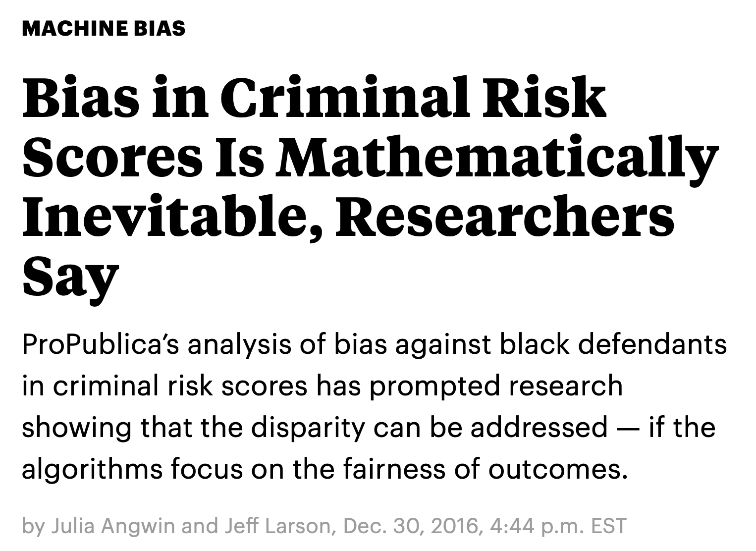
RACIAL BIAS IN CRIMINAL RISK SCORES
https://www.propublica.org/article/bias-in-criminal-risk-scores-is-mathematically-inevitable-researchers-say
M. BRAUN, FAIR, PRIVACY PRESERVING AND SECURE AI, STRATA LONDON 2019

Slide 5
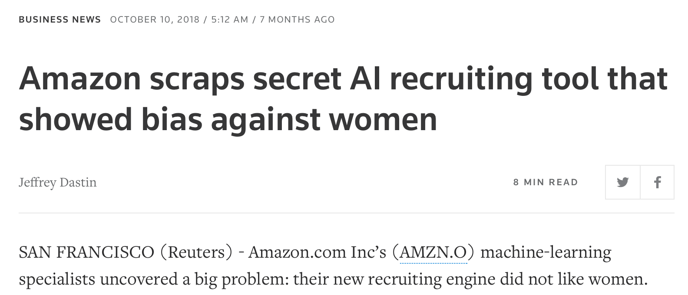
GENDER BIAS IN CV SCORING
https://www.reuters.com/article/us-amazon-com-jobs-automation-insight/amazon-scraps-secret-ai-recruiting-tool-that-showed-bias-against-women-idUSKCN1MK08G
M. BRAUN, FAIR, PRIVACY PRESERVING AND SECURE AI, STRATA LONDON 2019

Slide 6
RACIAL BIAS IN FACE RECOGNITION
https://www.theverge.com/2018/7/26/17616290/facial-recognition-ai-bias-benchmark-test
M. BRAUN, FAIR, PRIVACY PRESERVING AND SECURE AI, STRATA LONDON 2019

Slide 7
MODEL ACCURACY AND BIAS
We’re used to looking at performance metrics, but bias adds another dimensions as it matters how models perform for different parts of the data.
M. BRAUN, FAIR, PRIVACY PRESERVING AND SECURE AI, STRATA LONDON 2019

Slide 8
THE DATA IS BIASED BECAUSE THE WORLD IS
Sometimes we have accurate models, but there is bias in the data.
Resulting models are most likely still as biased.
Examples of systematic bias in society:
Gender gap in salary.
Education reached on origin.
What you can do: Check data for systematic bias before training.
M. BRAUN, FAIR, PRIVACY PRESERVING AND SECURE AI, STRATA LONDON 2019

Slide 9
DATA IS UNDER-REPRESENTED IMPORTANT AREAS
ML algorithms usually are designed to optimize for average performance.
Under-represented areas of data can lead to bias:
Worse accuracy
Under / overestimation
What you can do: make sure data is representative of application areas.
M. BRAUN, FAIR, PRIVACY PRESERVING AND SECURE AI, STRATA LONDON 2019

Slide 10
SELF-FULFILLING PROPHECIES AND OTHER PROBLEMS
As soon as predictions are influencing how you acquire data, more opportunity for systematic bias occurs.
(Harmless) example: you will get click data only for items your recommendation algorithm shows.
What you can do: it’s complicated.
M. BRAUN, FAIR, PRIVACY PRESERVING AND SECURE AI, STRATA LONDON 2019

Slide 11
DETECTING AND PREVENTING BIAS: THE IDEA OF EQUAL OPPORTUNITY
Calibrating for all groups is highly task specific and might also not be the right thing to do.
The notion of Equal Opportunity states that predictions must be equally accurate irrespective of protected attribute A.
Hardt et al, Equality of Opportunity in Supervised Learning, https://arxiv.org/abs/1610.02413
M. BRAUN, FAIR, PRIVACY PRESERVING AND SECURE AI, STRATA LONDON 2019

Slide 12
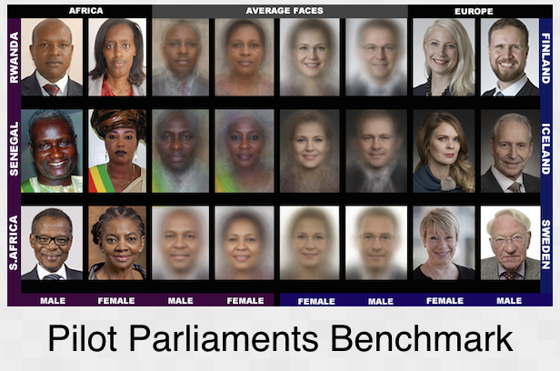
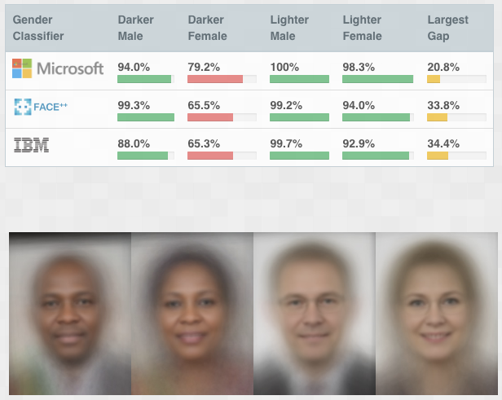
TEST FOR BIAS
Test suites, e.g.
http://gendershades.org/overview.html
M. BRAUN, FAIR, PRIVACY PRESERVING AND SECURE AI, STRATA LONDON 2019

Slide 13
FURTHER POINTERS AND RESOURCES
Conference on Fairness, Accountability, Transparency in ML (since 2014) http://www.fatml.org
Other ideas to quantify fairness:
Statistical Parity & Task specific similarity [1]
In ML methods:
Measure & re-balance data sets [2]
Working directly with the data [3]
[1] Dwork et al, Fairness through Awareness, https://arxiv.org/abs/1104.3913 [2] Dixon et al, Measuring and Mitigating Unintended Bias in Text Classification http://www.aies-conference.com/wp-content/papers/main/AIES_2018_paper_9.pdf [3] Ryu et al. InclusiveFaceNet: Improving Face Attribute Detection with Race and Gender Diversity, http://www.fatml.org/media/documents/inclusive_facenet.pdf
M. BRAUN, FAIR, PRIVACY PRESERVING AND SECURE AI, STRATA LONDON 2019

Slide 14
PRIVACY-PRESERVING AI

Slide 15
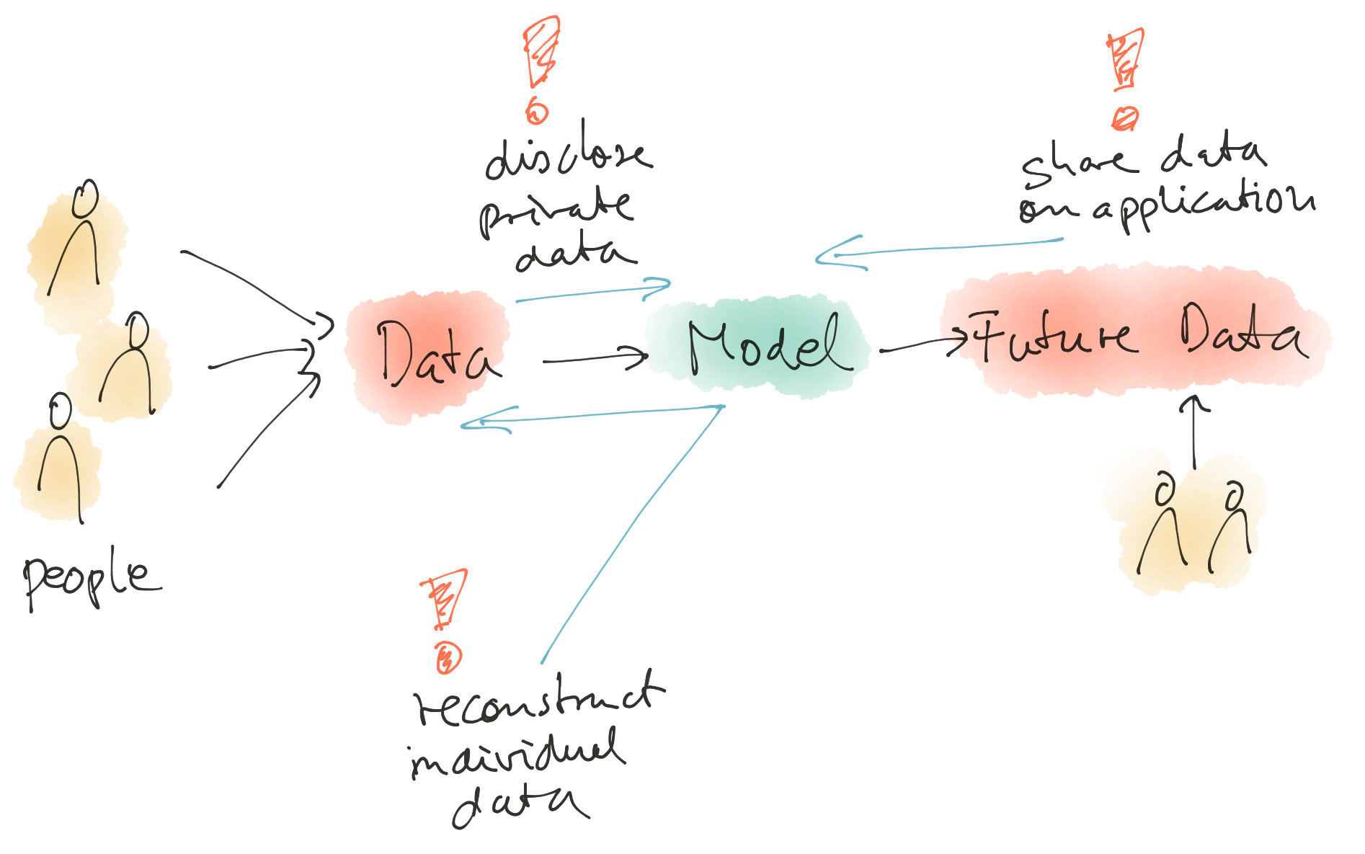
DATA AND MACHINE LEARNING
The general problem:
Data is key ingredient to ML powered AI systems, but data is also sensitive.
Challenges:
Unwanted reconstruction of private data
Using private data in training without disclosing too much data
Using ML systems without disclosing private data
M. BRAUN, FAIR, PRIVACY PRESERVING AND SECURE AI, STRATA LONDON 2019

Slide 16
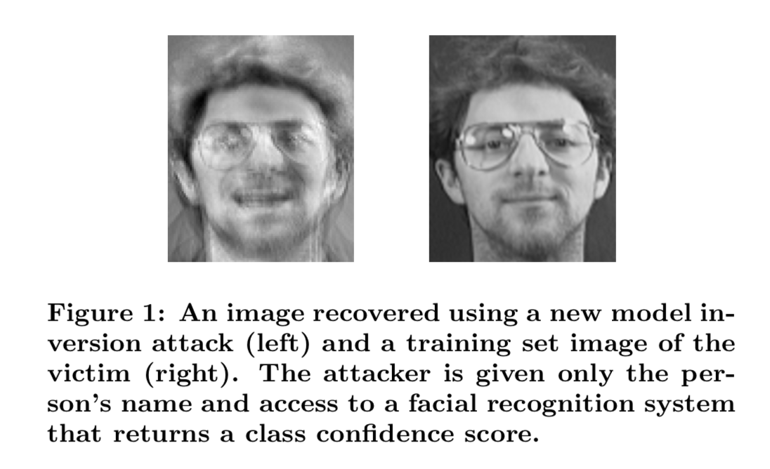
RECONSTRUCTING TRAINING IMAGES THROUGH MODEL INVERSION
It is possible to reconstruct (private) training examples by inverting models (with a bit of preprocessing).
Recommendation: quantize confidence measures to reduce ability to invert, use decision trees.
M. Frederiksen et al, Model Inversion Attacks that Exploit Confidence Information and Basic Countermeasures https://www.cs.cmu.edu/~mfredrik/papers/fjr2015ccs.pdf
M. BRAUN, FAIR, PRIVACY PRESERVING AND SECURE AI, STRATA LONDON 2019

Slide 17
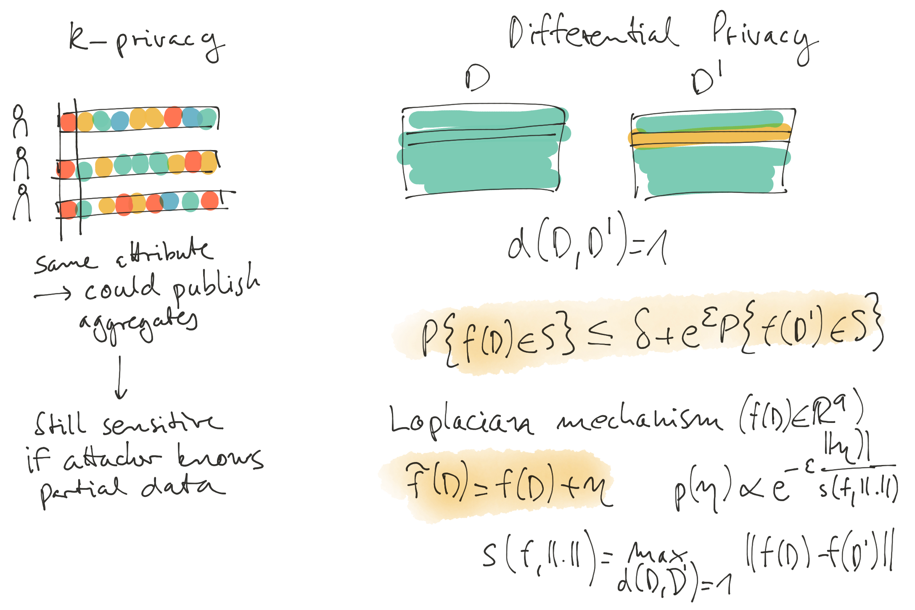
DIFFERENTIAL PRIVACY
Even in aggregates and other models learned from data, you might be able to recover data if you have partial information.
Differential privacy introduces noise to reduce information, to make models more independent of individual data points.
Introduce noise: in training data, cost function, weights, etc.
Ji et al., Differential Privacy and Machine Learning: A Survey and a review, https://arxiv.org/abs/1412.7584
M. BRAUN, FAIR, PRIVACY PRESERVING AND SECURE AI, STRATA LONDON 2019

Slide 18
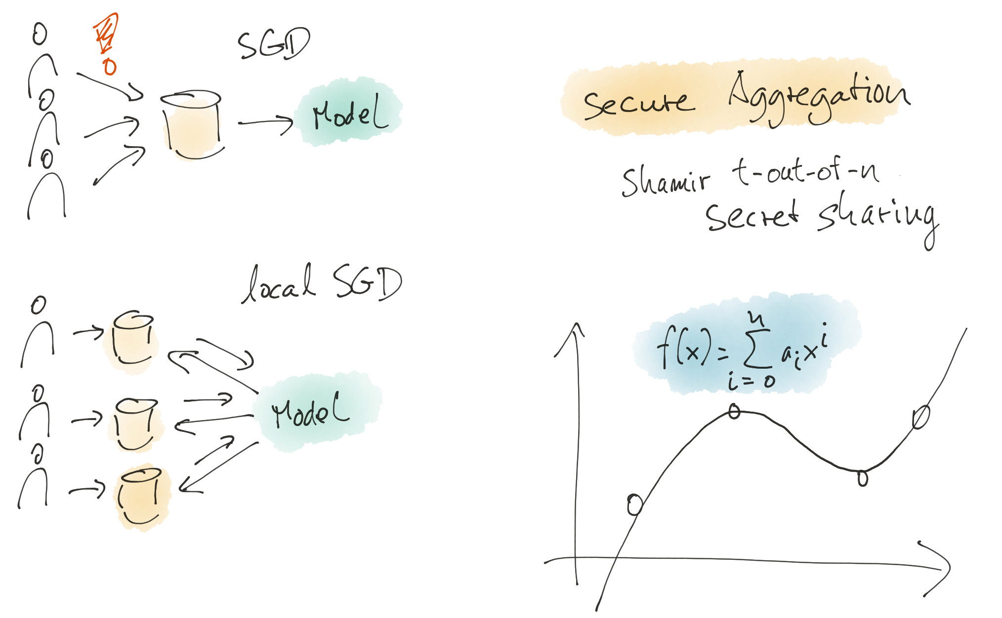
FEDERATED TRAINING
We don’t want to collect private data.
Federated training combines local stochastic gradient descent with secure sharing of secrets to train “on the edge” in a secure way.
Yang et al, Federated Machine Learning, Concept and Applications, https://arxiv.org/abs/1902.04885
MacMahan et al, Communication-Efficient Learning of Deep Networks from Decentralized Data, https://arxiv.org/abs/1602.05629
Bonawitz et al, Practical Secure Aggregation for Privacy-Preserving Machine Learning, https://eprint.iacr.org/2017/281
M. BRAUN, FAIR, PRIVACY PRESERVING AND SECURE AI, STRATA LONDON 2019

Slide 19
HOMOMORPHIC ENCRYPTION
When using MLaaS, you might not want to send private data.
There are ways to send encrypted data such that the model ends up computing an encrypted version of the output.
Challenges:
Encryption uses noise (salt) for security, bounds depth of computation.
Bootstrapping can be used to clean cipher text with certain encryption schemes.
Minelli, Fully Homomorphic Encryption for Machine Learning, https://www.di.ens.fr/~minelli/docs/phd-thesis.pdf
M. BRAUN, FAIR, PRIVACY PRESERVING AND SECURE AI, STRATA LONDON 2019

Slide 20
SECURE AI

Slide 21
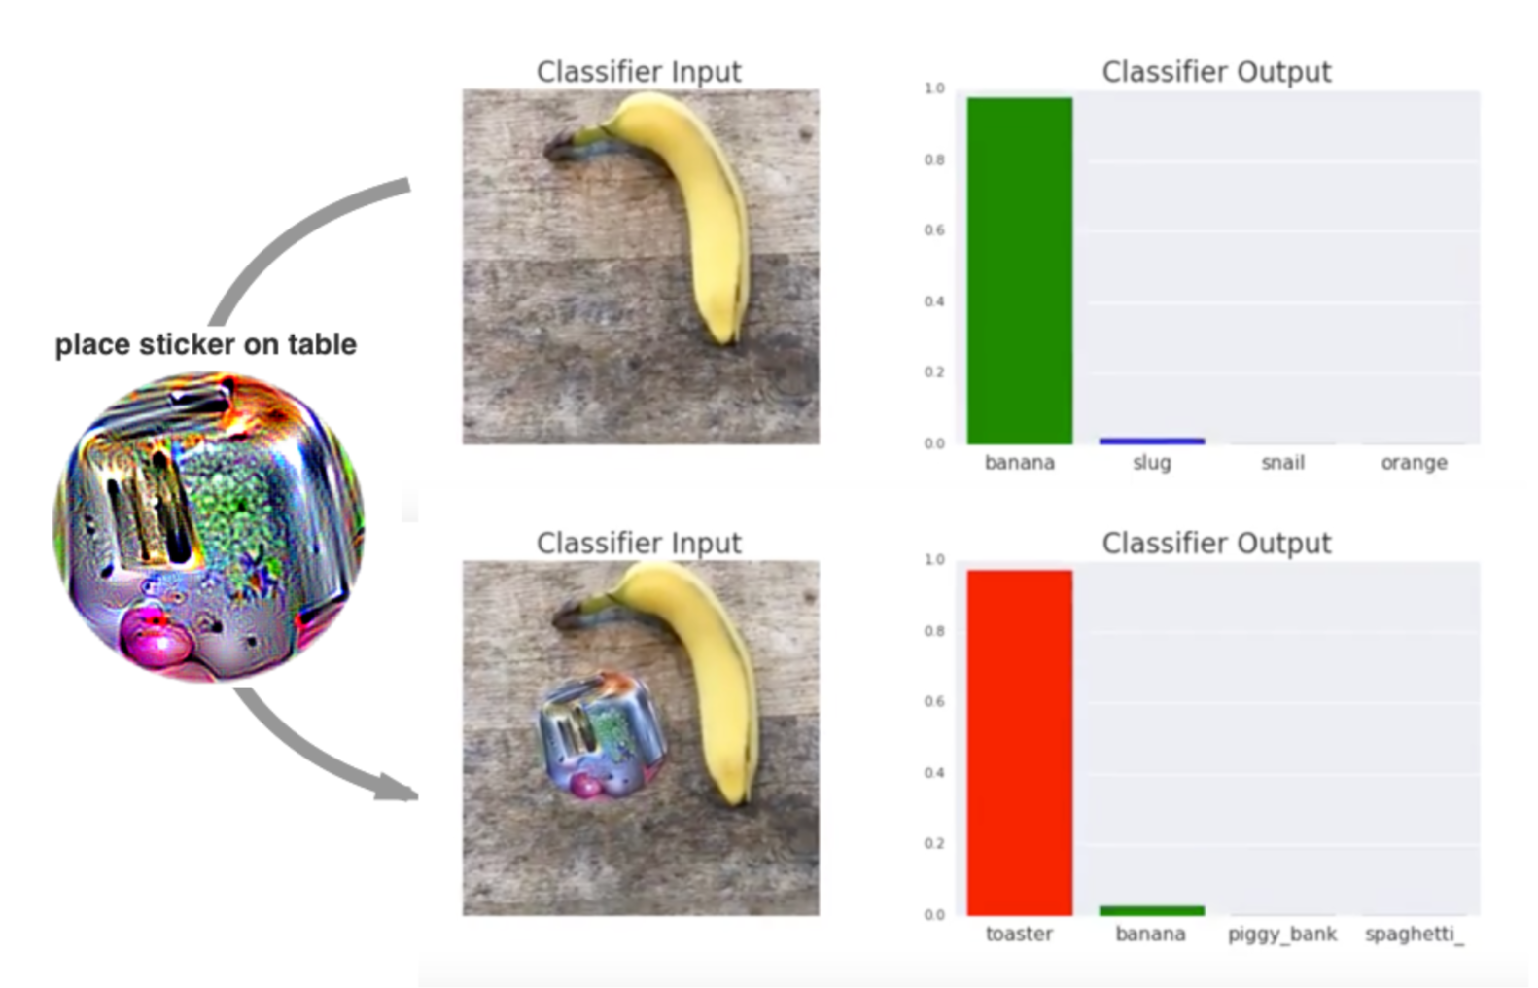
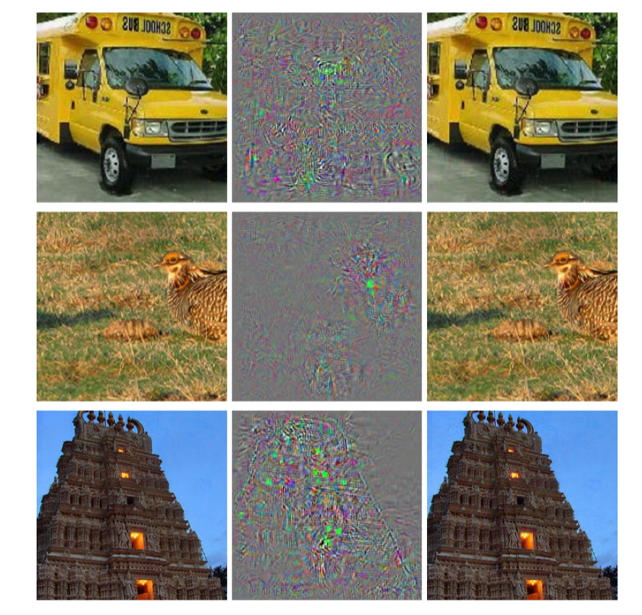
ADVERSARIAL EXAMPLES
Szegedy et al, Intriguing properties of neural networks, https://arxiv.org/abs/1312.6199
Brown et al, Adversarial Patch, https://arxiv.org/abs/1712.09665
M. BRAUN, FAIR, PRIVACY PRESERVING AND SECURE AI, STRATA LONDON 2019

Slide 22
HOW IS THIS POSSIBLE?
Simple optimization problem:
Maximize prediction for some other label while restricting the perturbation.
Okay, but why?
M. BRAUN, FAIR, PRIVACY PRESERVING AND SECURE AI, STRATA LONDON 2019

Slide 23
HIGH DIMENSIONAL SPACES ARE WEIRD
M. BRAUN, FAIR, PRIVACY PRESERVING AND SECURE AI, STRATA LONDON 2019

Slide 24
ADVERSARIAL TRAINING
Make systems more resilient by ensuring that they are stable against local perturbations.
Keep in mind: high dimensional spaces are weird, and don’t expect ML to work as you would think they would.
Tramèr et al, Ensemble Adversarial Training: Attacks and Defenses, https://arxiv.org/abs/1705.07204
M. BRAUN, FAIR, PRIVACY PRESERVING AND SECURE AI, STRATA LONDON 2019

Slide 25
OUTLOOK

Slide 26
WHAT IF AI IS BECOMING TOO POWERFUL?
Radford et al, Better Language Models and Their Implications, https://openai.com/blog/better-language-models/
M. BRAUN, FAIR, PRIVACY PRESERVING AND SECURE AI, STRATA LONDON 2019

Slide 27
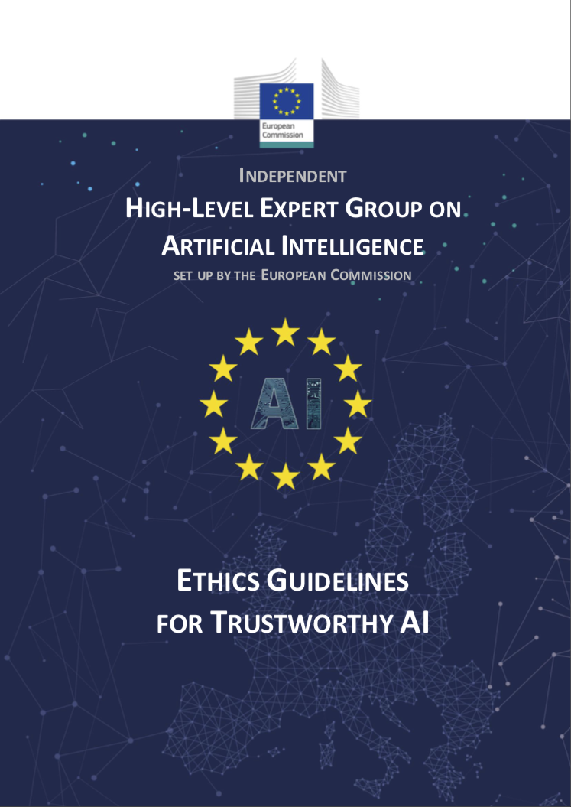
EU GUIDELINES ON “TRUSTWORTHY AI”
7 recommendations
Human agency and oversight
Technical robustness and safety
Privacy and data governance
Transparency
Diversity, non-discrimination and fairness
Societal and environmental well-being
Accountability
https://ec.europa.eu/futurium/en/ai-alliance-consultation
M. BRAUN, FAIR, PRIVACY PRESERVING AND SECURE AI, STRATA LONDON 2019

Slide 28
SUMMARY
AI technology ultimately affects people and impacts their life.
There is no built-in protection against bias, if it is in the data, the data is underrepresented, or closed loop uses of predictive systems. But we can test our system for bias and uniformly good accuracy.
AI technology like ML uses data, and there are ways to restrict the individual’s data point in the training, models, and application of AI.
ML systems work differently than us, which may lead to surprising failure modes.
M. BRAUN, FAIR, PRIVACY PRESERVING AND SECURE AI, STRATA LONDON 2019

Slide 30
Please write contact name, department and position in all capital letters
MIKIO BRAUN
PRINCIPAL RESEARCH ENGINEER
mikio.braun@zalando.de
01-05-2019

